Slide 1
Lecture 5
Potential Energy Surfaces

Slide 2
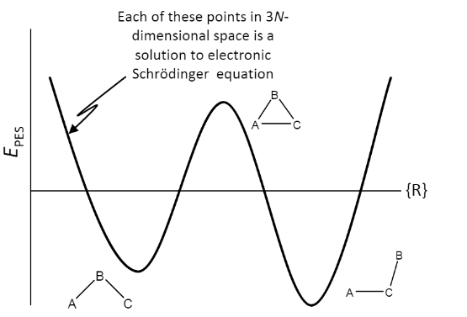

What is a PES?
A function relating energy and coordinates of some DOF (spatial, rotational, atomic, etc.).

Slide 3
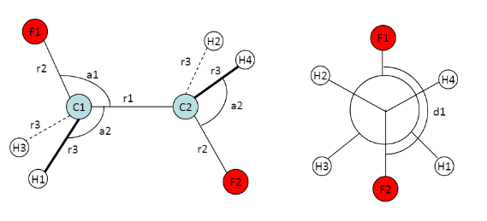
Specifying Atomic Coordinates
Two most common methods:
Cartesian Coordinates
-3N coordinates
Z-matrix:
-Zero redundancy
-Specify atom pairs, angles, and dihedrals.

Slide 4
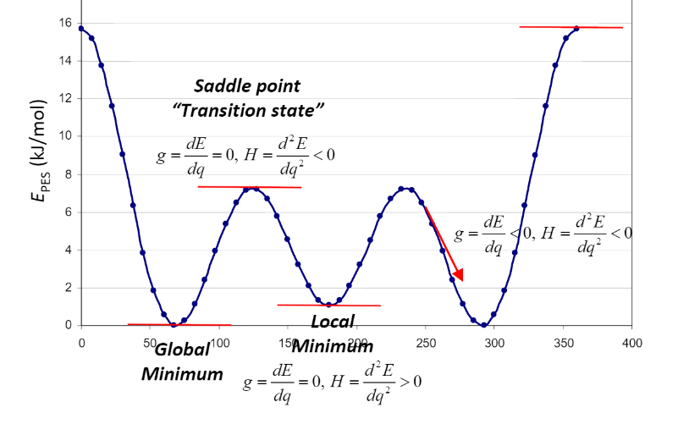
Energy vs. Dihedral Angle (1 DOF)

Slide 5
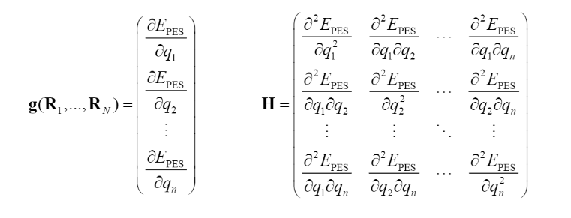
Generalization for Higher DOF Systems
When looking at multiple degrees of freedom, the gradient vector and Hessian matrix tell us information about our system.
Local and Global Minima are stable atom configurations.
First Order Saddle Points correspond with transition states.
Higher Order Saddle Points always lead to a first order saddle point.
Minimum Energy Pathway shows the path a marble with infinite inertia would follow.

Slide 6
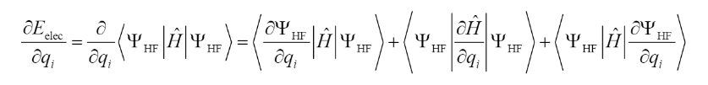
How do we get these derivatives?
Hellman-Feynman Theorem: If the wavefunction is an eigenfunction of the Hamiltonian, the first and third terms above cancel. Not the case with LCAO basis sets because wavefunction depends on nuclear coordinates.
Second derivatives can be solved analytically by solving the ‘Coupled-Perturbed Hartree Fock’ equations.

Slide 7
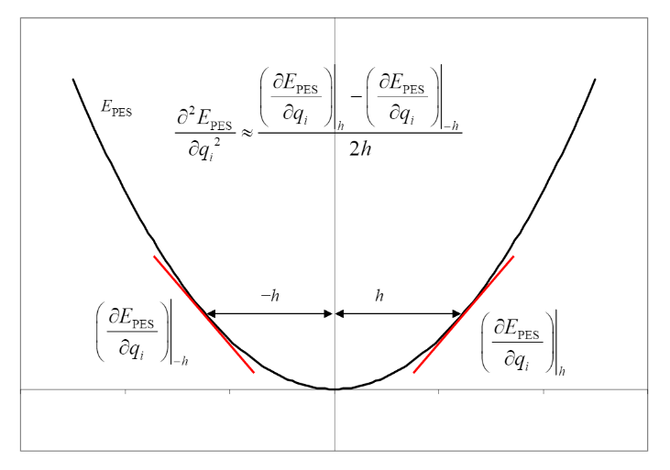
2nd Derivative Estimation
If Epes is harmonic, 2nd derivative can be approximated by taking a difference in first derivatives.
Require that h be small enough that we stay in the harmonic region.

